Slide 1



Online Control Adaptation for Safe and Secure Autonomous Vehicle Operations
Mahmoud Elnaggar¹, Jason D. Hiser², Tony X. Lin³, Anh Nguyen-Tuong², Michele Co², Jack W. Davidson², and Nicola Bezzo^{1,3}

Slide 2
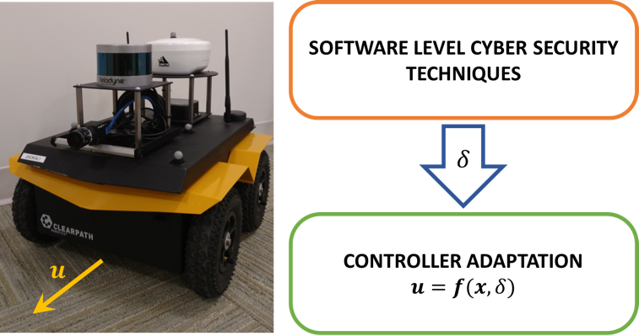

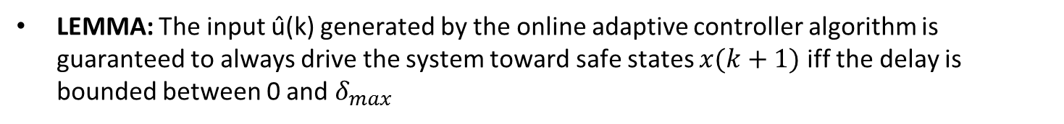
Online Control Adaptation for Safe and Secure Autonomous Vehicle Operations
MOTIVATION: Applying cyber security techniques to autonomous vehicles can incur runtime overheads that may result in unsafe performance of the autonomous vehicles.
PROBLEM: Online control performance adaptation for secure and safe navigation of autonomous vehicles.
RISK-BASED APPROACH:
Deployment of Cyber-security protection techniques.
Model Predictive Control to compute the inputs considering different delays.
Risk analysis: computation of a risk factor that indicates the accuracy of the estimated delay.
Computation of the adapted controller input.
LEMMA: The input û(k) generated by the online adaptive controller algorithm is guaranteed to always drive the system toward safe states $x(k+1)$ iff the delay is bounded between 0 and $δ_{max}$
July 14, 2017
Notes:
Rim the video,
Move simulation to the 2nd slide
Add lemma to the first slide (showing that we can guarantee safety as long as delahy is less than delta_max)

Slide 3
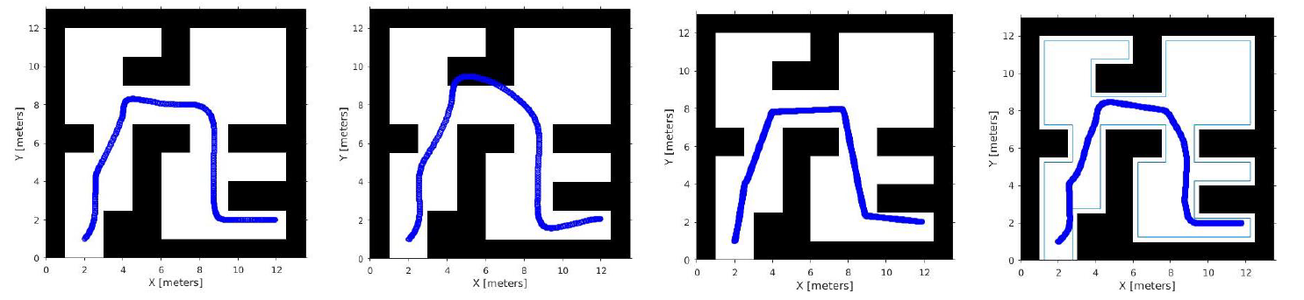
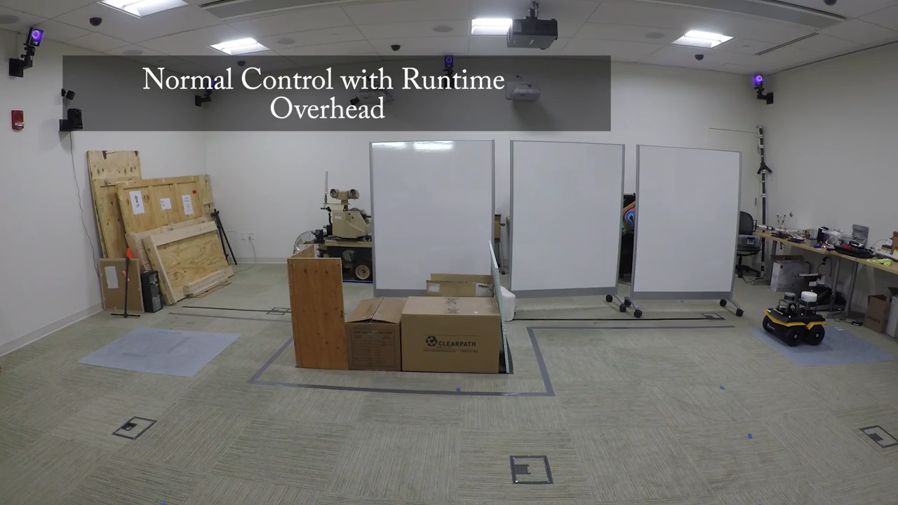
Online Control Adaptation for Safe and Secure Autonomous Vehicle Operations
SIMULATION RESULTS:
EXPERIMENTAL RESULTS:
July 18, 2017
Notes:
- Go over simulation results
- End the presentation with a concluding statement

